Slide 1
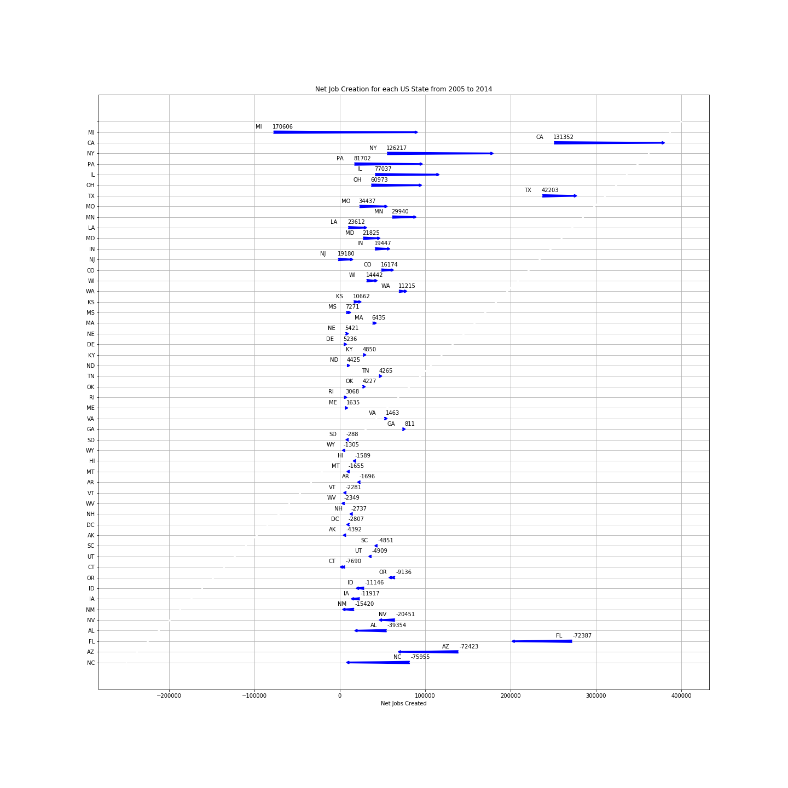
Net Jobs Created per each US State (2005 – 2014)

